Slide 1
Python programming
unit B5 – time series

Slide 2
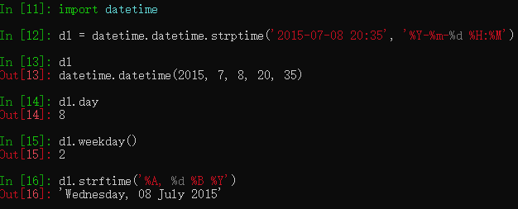
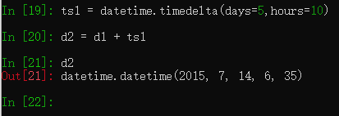
Deal with date/time
Python datetime class
The timedelta can give parameter upto weeks. Cannot have months or years.

Slide 3
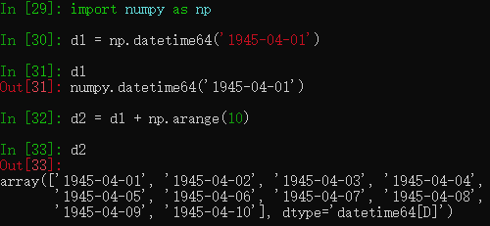
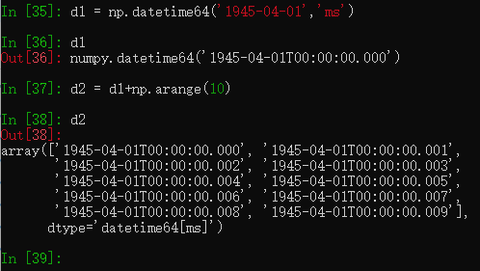
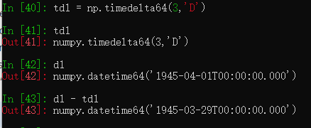
Deal with date/time
Numpy datetime64
Support only the fixed format of string. Not flexible format

Slide 4
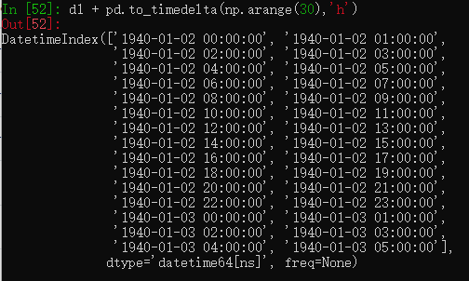
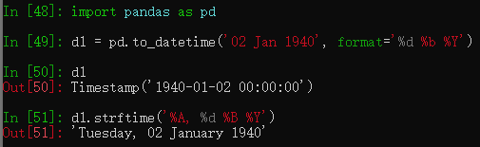
Pandas timestamp and timedelta
Pandas.to_datetime(): create timestamp
Pandas.to_timedelta(): create a time span
Can be used to create array. Also has the function like python datetime for easy of use.
Pandas uses numpy datetime64[ns]

Slide 5
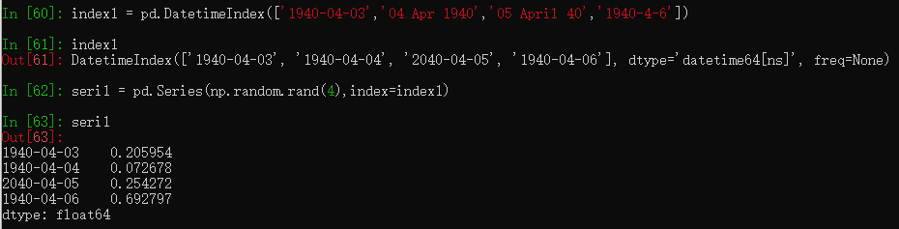
Pandas timeseries
For time series, column label are features, row index are time / date.
Pandas can create datetime index, and use it for Series or DataFrame.
When the index is using DatetimeIndex, it is called a time series.

Slide 6
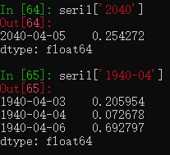
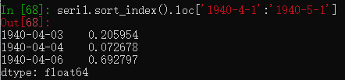
Pandas timeseries - datetimeindex
You can filter timeseries data with the datetime range, or slicing it with datetime

Slide 7
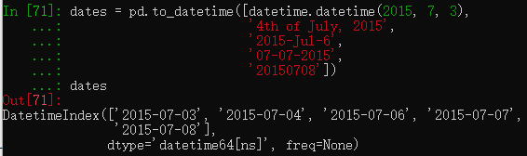
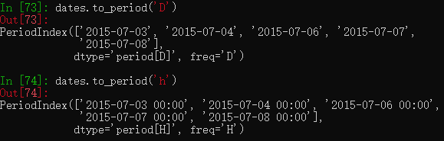
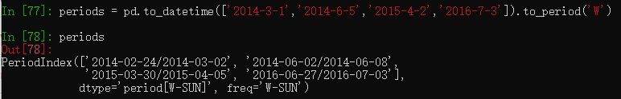
Pandas timeseries – periodindex
Pandas.to_datetime() function can also create DatatimeIndex object.
PeriodIndex is used to specify a period. The datetime64[ns] is used for timestamp, but for period dtype will be special ‘period[D]’. Period will start and end in certain fixed ways. Like month begin and month end for ‘M’. Or Sunday to Saturday for ‘W’.

Slide 8
Timeseries manipulation
asfreq(): change the series frequency.
resample(): change frequency and make Resampler object ready for manipulation of the data
rolling(): roll data and make a Window/Rolling object ready for manipulation of the data
shift(): shift the timeseries index by the desired number of periods.
groupby() – use special datetime related value for grouping. E.g. (df.index.dayofweek, data.index.time, df.index.to_period(‘M’),)

Slide 9

stationarity
Stationarity: means that the probabilistic character of the series must not change over time, i.e. that any section of the time series is "typical" for every other section with the same length.
mathematical meaning: for a time seris of $\{x_{t}, t=0, 1, 2, … , n\}$, for each time $t$, treat the $x_{t}$as a random variable, then
$E(x_{t})=μ_{t}$ is constant, not changing with $t$. so $E\left(x_{t}\right)=μ for any t$
$Cov(x_{t+k}, x_{t}) = E[(x_{t+k}−μ_{t+k})(x_{t} − μ_{t})] = E[(x_{t+k} −μ)(x_{t} − μ)]$ is constant, not changing with $t$. so $Cov(x_{t+k}, x_{t}) = E[(x_{k} − μ)(x_{0} − μ)]$only depends on $k$

Slide 10
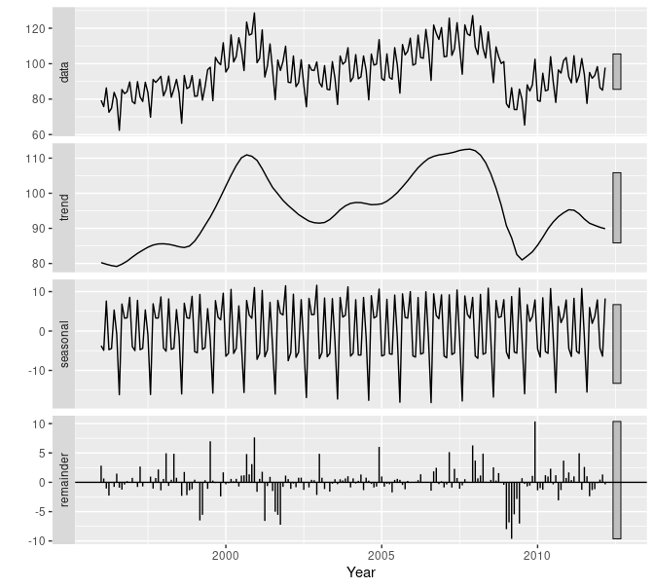
Data decomposition
A time series data may show different components:
Trend: A slow but significant change of the values over time
Season: A change that is cyclical and has a period of less than one year
Cycle: A change that is cyclical and has a period of longer than one year
Random: A component that is random; the best model for purely random data is the mean, given that it has a distribution corresponding to the normal distribution
Many software will process for season + cycle together as one category.

Slide 11
packages
Statsmodels: currently this package has some good functions made for time series data analysis
Seasonal_decomposed(), this function will decompose the data
Adfuller(), this function to test if data is stationary
ARIMA model for prediction

Slide 12
tasks
DATA SETS FOR HIPEL AND MCLEOD BOOK
http://ftp.uni-bayreuth.de/math/statlib/datasets/hipel-mcleod
The dataset is from a book by Hipel and McLeod. (K.W. Hipel and A.I. McLeod (1994), "Time Series Modelling of Water Resources and Environmental Systems")
It is a record of many years, daily record of temperature.
Monthly-car-sales-in-Quebec-1960
From Kaggle
https://www.kaggle.com/dinirimameev/monthly-car-sales-in-quebec-1960/version/2
Or from github to get the data file
https://github.com/jbrownlee/Datasets/blob/master/monthly-car-sales.csv
Build ARIMA model and forecast

